Slide 1
Threat or challenge? Measuring cognitive workload and physiological arousal to infer mental state
Alexander Todd¹, Reilly Innes¹, Alireza Mazloumi Gavgani², Timothy Whelan², Ebon Baxter¹, Murray Bennett¹, Scott Brown¹, Eugene Nalivaiko², Ami Eidels¹
¹School of Psychology, University of Newcastle, Callaghan, Australia
²School of Biomedical Sciences and Pharmacy, University of Newcastle, Callaghan, Australia

Slide 2
Air Traffic Controllers (ATC)
Highly demanding
Constant traffic
Heathrow – 1 plane every 45 seconds
Sydney – 20 every 15 minutes
Very serious consequences
So how do we train people for this?

Slide 3
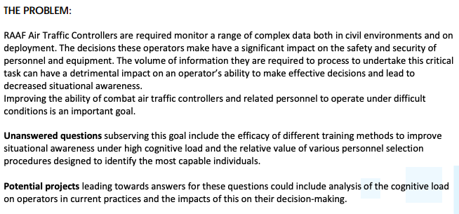
ATC-DIN Project
Notes:
In collaboration with UTS (CT, Avnash, Ann), Defence (Anselm), Western Sydney (Morley), Sydey (Kay Double), biomedical science and cognitive sciences

Slide 4
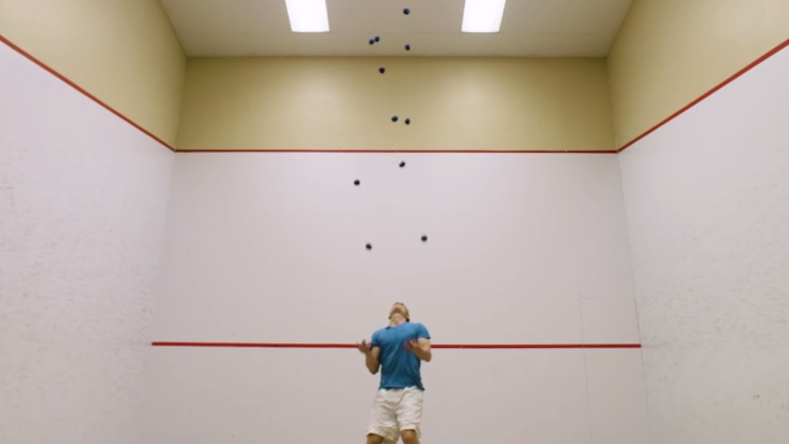
Cognitive Workload
Cognitive Workload = level of how hard you’re working
Restricted by your capacity
Amount of resources being used
Affects task performance
Higher workload >>> less resources available

Slide 5
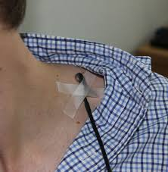
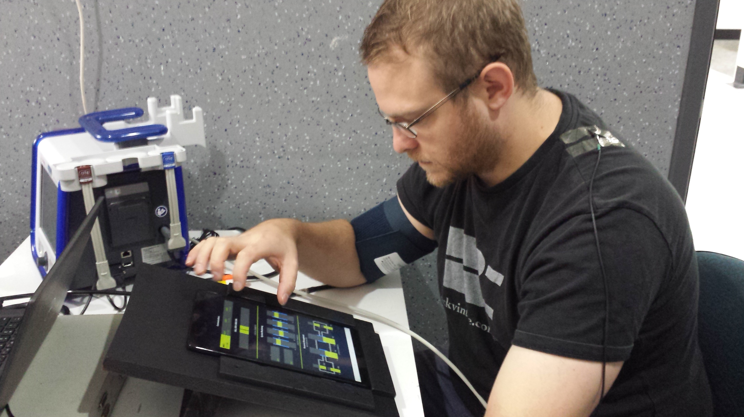
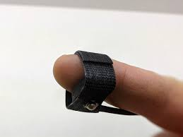
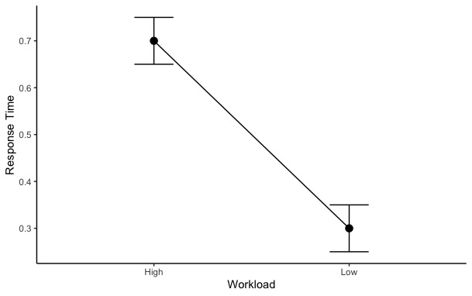
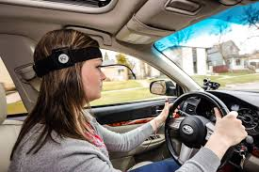
DRT and typical patterns

Slide 6
Motivational State
Situation
Different people react differently to pressure scenarios
Could be challenged
Perceived sufficient (or nearly) resources to match demands
Could be threatened
Perceived insufficient resources to match demands
Biopsychosocial model of performance
Affect
Cognition
Physiological Response
Affective Appraisal
Semantic Appraisal
Demands | Resources
Physiological Response
Notes:
Lazarus originally just cognition and behaviour. BPS created to incorporate physiology. Makes C&T on a continuum. New models such as theory of challenge and threat state in athletes all rooted in BPS but scenario specific.

Slide 7
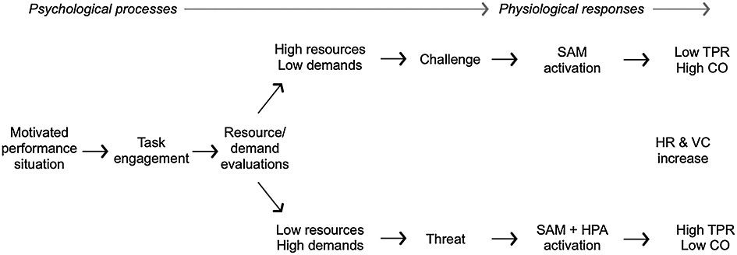
Physiological Underpinning
Challenge – Sympathetic Adreno Medullary axis
Increased contractility, stroke volume, HR and cardiac output
Decline in vascular resistance
Unchanged blood pressure (TPR)
Threat – Pituitary Adrenal Cortical axis
Increased contractility, stroke volume, HR and cardiac output
Unchanged vascular resistance (sometimes increase)
Increase in blood pressure (TPR)

Slide 8
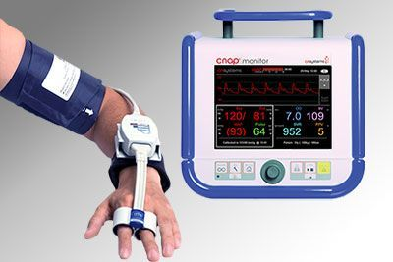
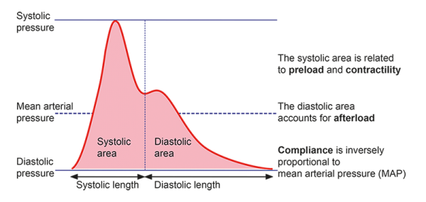
The Glove
Measure state using CNAP
Continuous Non-invasive Arterial Pressure
“gold standard”
Measures:
Blood pressure
Hemodynamics (i.e. changes)
Rhythms
Pulse waves
Stroke volume & pulse pressure
Uses pulse contour analysis

Slide 9
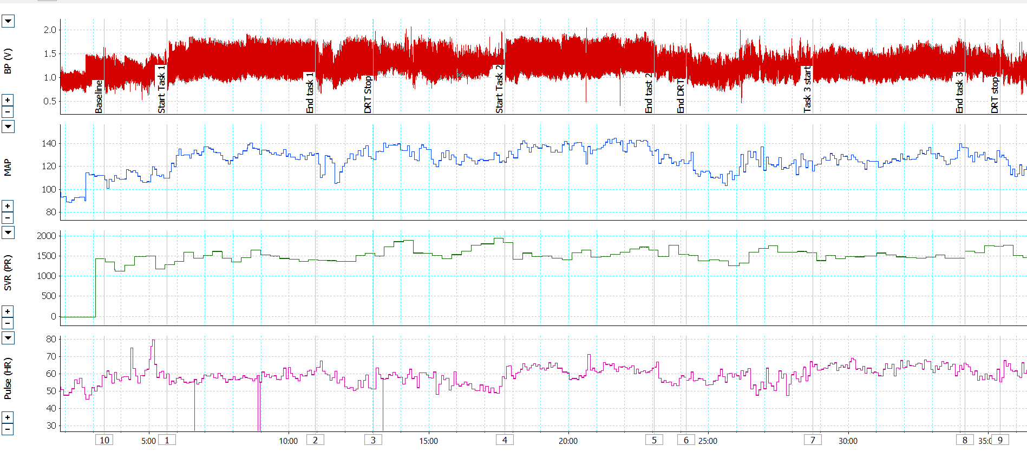
Screenshot of biometric recording during Collision Detection Task
BP: blood Pressure SVR: Systemic vascular resistance (SVR)
MAP: mean arterial pressure Pulse: Heart rate

Slide 10
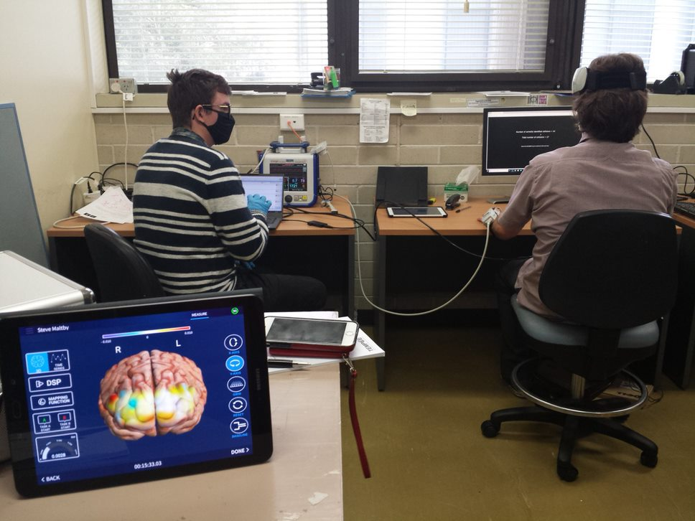
Our study
Workload
+
Physiological State
What happens?
Can it be manipulated?
Reliable measures?

Slide 11
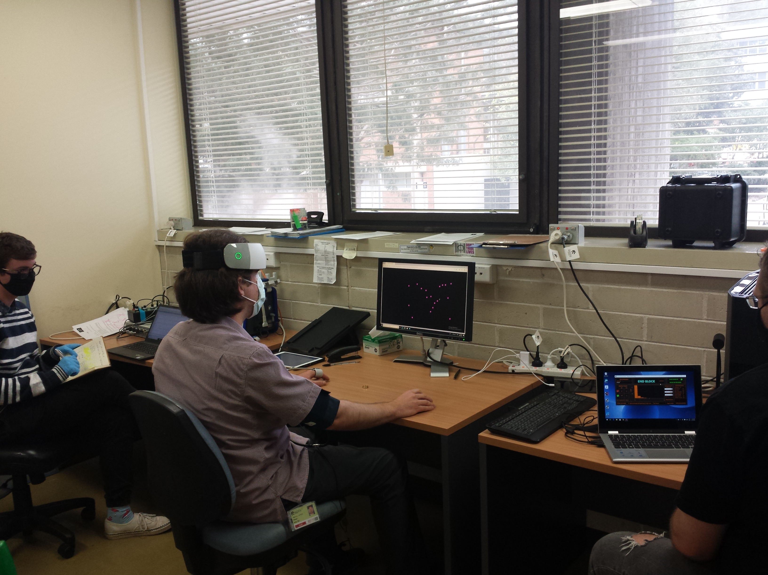
Our study
Setup
At least 2 experimenters

Slide 12
Our study
Setup
Covid safe

Slide 13
Our study
Setup
The glove goes on the non-dominant hand
Blood pressure monitor on as well

Slide 14
Our study
Setup
DRT runs as per normal
Press a foot pedal (dominant foot)

Slide 15
Our study
Setup
Fancy head wear
Related to another experiment
fNIRS

Slide 16
Our study
Main tasks:
Collision Detection
Cedar OWAT

Slide 17
Collision Detection
Must detect which objects will collide
15 second trials
Several difficulty levels
Performance = Detections and RT

Slide 18
Cedar OWAT
Must react to situations and instructions
Audio and Visual
Several difficulty levels
Performance = number of actions

Slide 19
Preliminary Results
OWAT & Collision
DRT
Glove

Slide 20
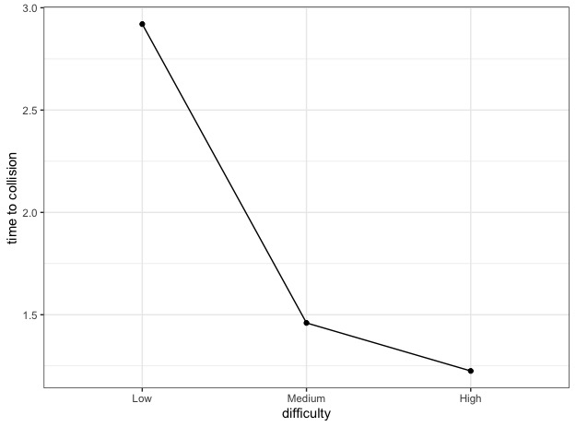
Collision Detection

Slide 21
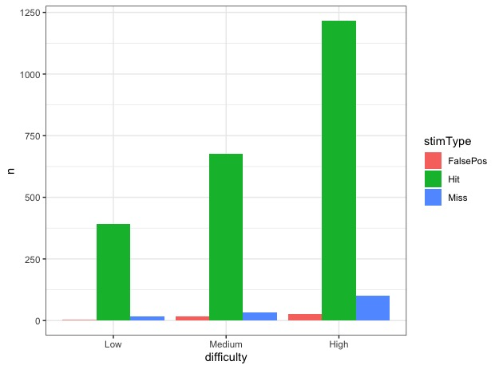
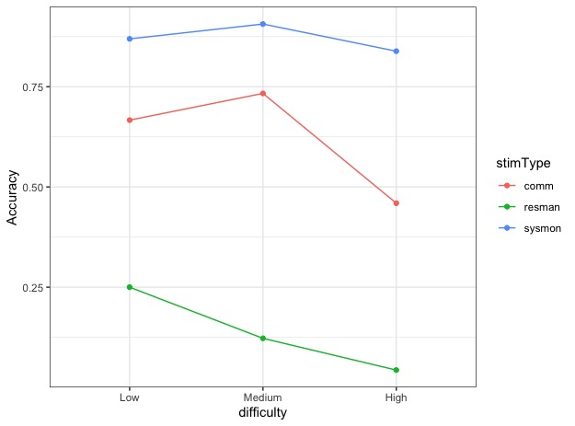
OWAT

Slide 22
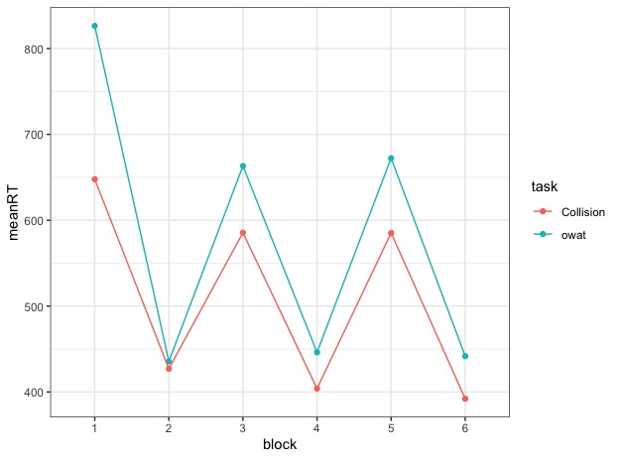
DRT

Slide 23
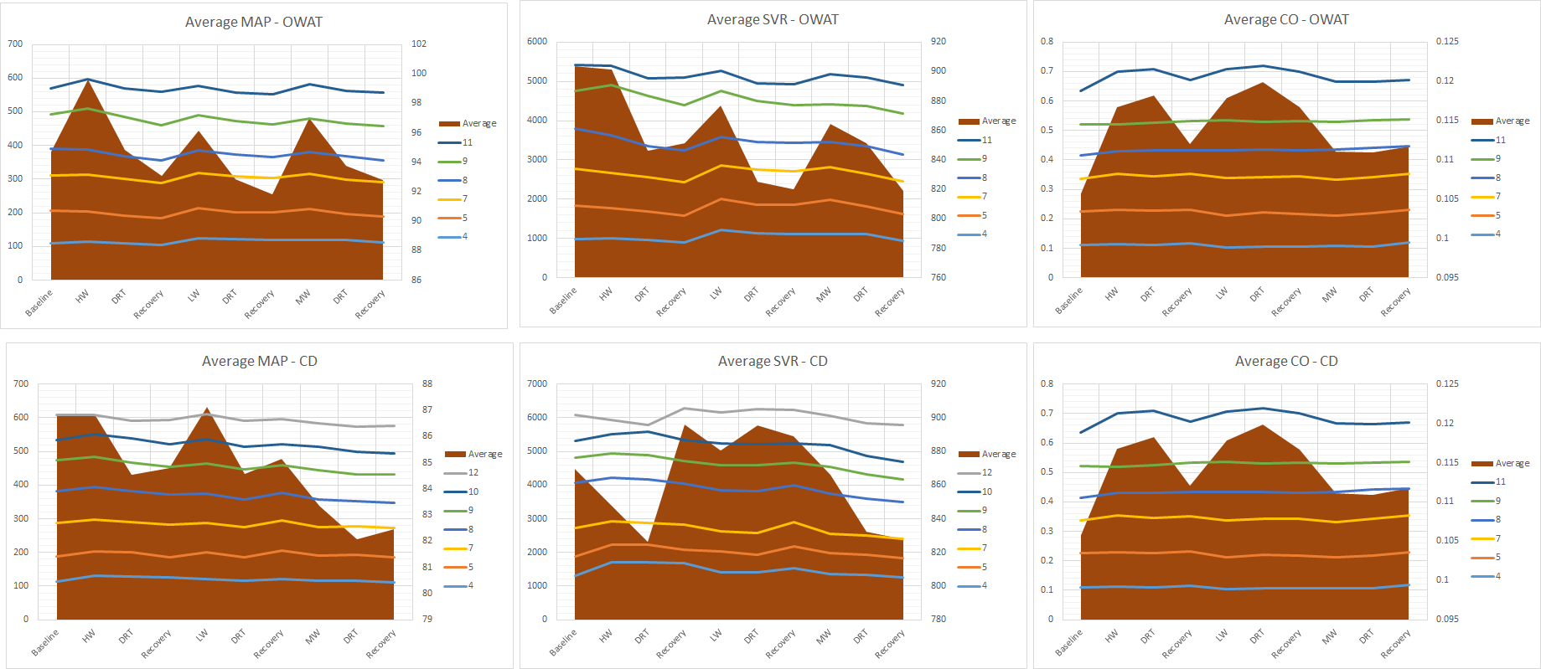
Glove Results

Slide 24
Conclusions
Tasks moderate workload
DRT captures workload change
Glove captures workload change
Observe challenge patterns
Observe threat patterns
In lab workload-state manipulation
Notes:
Ecologically valoid

Slide 25
What’s Next?
Is DRT affected by state?
Online study
Include “consequences” to illicit threat
Extend to personnel selection
Already some work done with RAAF
Extend this to training
i.e. train challenge states
Extend to real world
Working with ATCs

Slide 26
Cheers
Project Leads:
Eugene Nalivaiko – Biomedical Sciences UoN
Rohan Walker – Biomedical Sciences UoN
Ami Eidels – Newcastle Cog Lab
Scott Brown – Newcastle Cog Lab
Researchers:
Alireza Mazloumi Gavgani - Biomedical Sciences UoN
Alexander Todd: data collection and writing
Murray Bennett: data collection and coding
Timothy Whelan: data collection
Ebon Baxter: data collection
Collaborators
CT Lin, Avinash Singh, Alka John – UTS
Anselm Fatiaki – Defence

Slide 27
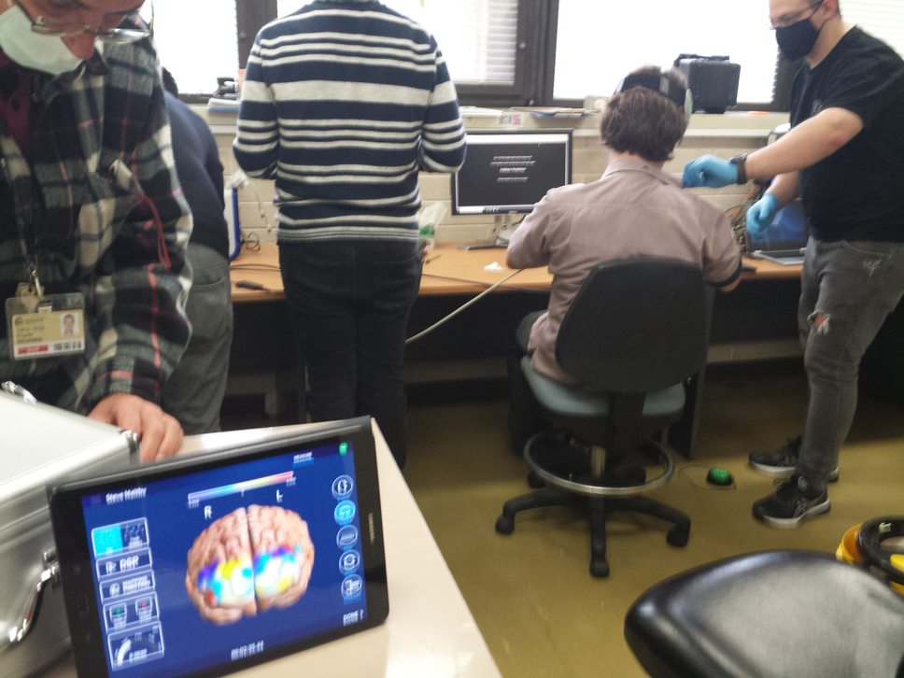

Slide 28
Online study
Multiple Object Tracking
NO glove >>> Only DRT
Between Subjects
Threat/Challenge Framing
Results
No difference (individual differences?)
BUT – Poor MOT performance = More threatened.

