Slide 1
PMwG Sampler and stuff we’ve been doing with it
and other things, I swear I don’t just talk about the sampler I do have a life

Slide 2
“What is it?”
Particle Metropolis within Gibbs Sampling
A type of MCMC algorithm for estimating model parameters given a (tractable) likelihood function
General MCMC estimates parameter by parameter
Think of all those chains
PMwG estimates a vector of parameters
The alpha (of samplers)

Slide 3
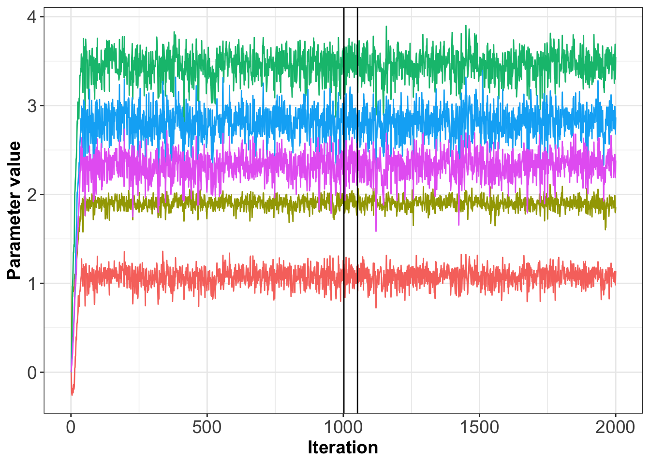
“What is it?”

Slide 4
“What is it?”
Gibbs sampling for Group level parameters
Theta
Multivariate normal distribution
Means we get covariance too
Particle Metropolis for subject level parameters
Alpha
MCMC but with particles

Slide 5
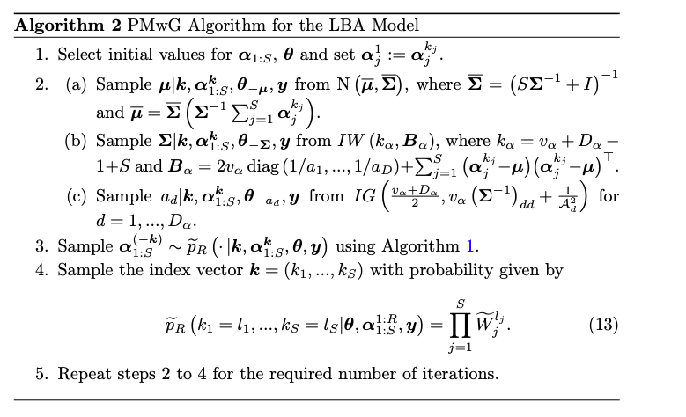
The algorithm

Slide 6
Efficiency
Normally, models can be horrifically inefficient
We use an adaptive proposal distribution to get great particle proposals for parameters
Individually tuned sampling distributions
Use alpha mu and past samples to create conditional distribution
This makes the process accurate and efficient

Slide 7
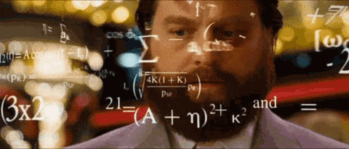
Why would anyone care?
Models dude, just models
Efficiency
Hierarchical estimation
Accuracy – recovers very well
Great outputs
A nice guide book

Slide 8
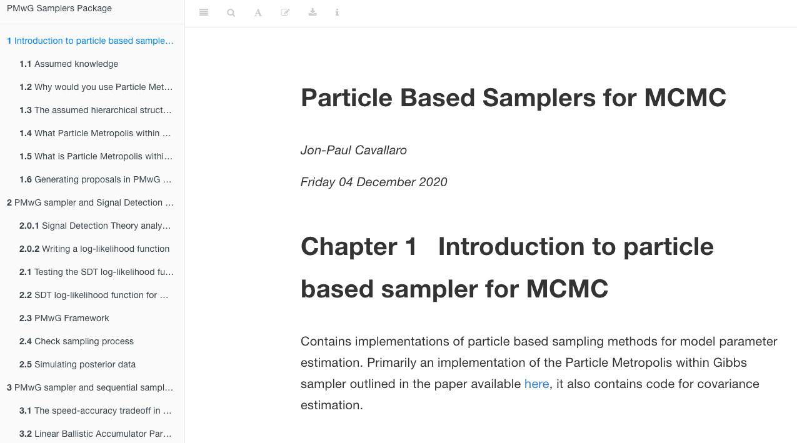
“Okay, so I care, but only a bit”
Great, theres an R package and a document
These are live and working – some minor bug fixes being added to package and additions to bookdown
https://newcastlecl.github.io/samplerDoc/

Slide 9
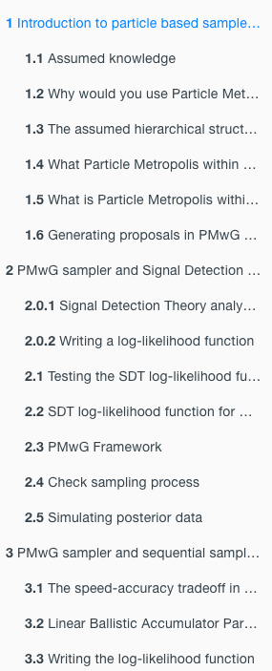
Navigating the doc
Intro
SDT Example
Basic functionality and requirements (writing a likelihood function)
Checking outputs
Posterior Predictive data
LBA example
An LBA example
Model Comparison
Complex
More complexity
Troubleshooter
Common problems and fixes

Slide 10
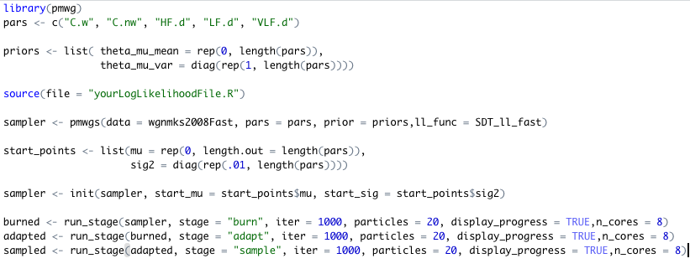
Using the package

Slide 11
Some additional things
Priors
You need to specify your own – they follow the MVN distribution
Start points
You can specify start points if you want
adaptation stage
Needs to get 20 unique samples per participant (can be specified)
This allows the conditional to be created
Can be troublesome for some participants (a fix is being prepared)
Tuning
Getting n particles right can be tricky (a function is being prepared)

Slide 12
What we’ve been using it for
Modelling – duh
But cool models too
More efficiency and testing some old data
And a tutorial paper is coming along

Slide 13
Projects
Overkill for many things
Scott with covid incubation time

Slide 14
Covid Incubation Times
Looked at a meta-analysis of papers reporting on clusters
3 different models of incubation times
Gamma
Weibull
Lognormal
Top was 15 days
Mostly done by 10 days

Slide 15
Projects
Overkill for many things
Scott with covid incubation time
JP Cavallaro consumer choice data (TRDM and other model)

Slide 16
Timed-Racing Diffusion model
Looked at 3 choice options (phones)
Varied price, quality options
Selected best option
Also had speed/accuracy manipulation
Modelled with a timed-racing diffusion model
Results coming through

Slide 17
Projects
Overkill for many things
Scott with covid incubation time
JP consumer choice data (TRDM and other model)
Gavin Cooper consumer choice and SDT

Slide 18
Gavin Coopers SDT models with LBA
Choice experiment with 2 options (hotels)
Varied price/quality
Had to choose given a criteria
I.e. must be above 3 star and/or under $500
Grouped via SDT signals
Parameters estimated for SDT signal

Slide 19
Projects
Overkill for many things
Scott with covid incubation time
JP Cavallaro consumer choice data (TRDM and other model)
Gavin Coopers consumer choice and SDT
RAAF data

Slide 20
Military people vs Students
Thesis work – focus on workload
Part of ongoing collaboration between UoN and RAAF
Did a multiple object tracking task and DRT
Tracked 0,1 or 4 dots and did the workload task
Joint behavioural model
LBA for saying “was this a target or not?”
Shifted-Wald for DRT

Slide 21
Experiment
DRT
Target?
(no)
MOT

Slide 22
Joint Model
S-Wald
$$Ω$$
LBA
Covariance
DRT Responses
MOT Decisions

Slide 23
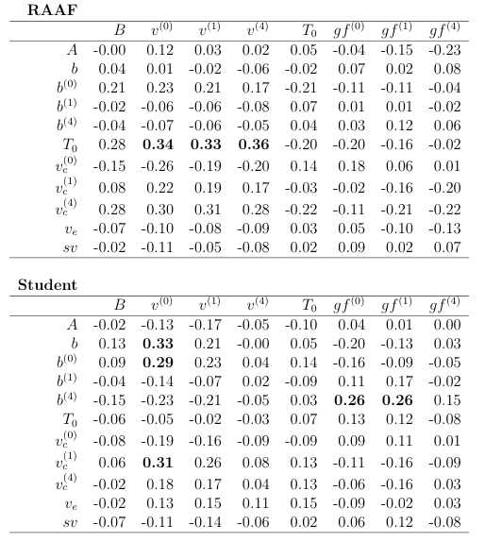
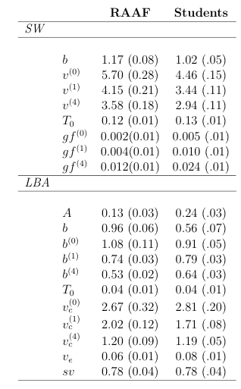
DRT
DRT
MOT
MOT

Slide 24
Conclusion
DRT
$$Ω$$
MOT
Optimal trade off
Fast
Better overall
More motivated?
Bad trade off
Slower
Worse overall
Less motivated?
>

Slide 25
Projects
Overkill for many things
Scott with covid incubation time
JP Cavallaro consumer choice data (TRDM and other model)
Gavin Cooper consumer choice and SDT
RAAF data
Laura Wall data

Slide 26
Laura Walls data
Looked at within and across task relationships
Re-analysed in vs out of scanner data
Analysed three cognitive tasks data

Slide 27
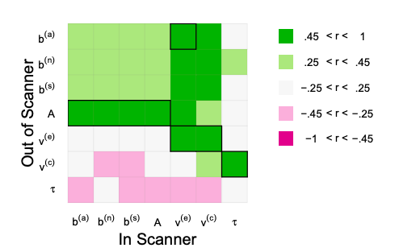
Re-analysis of in vs out of scanner

Slide 28
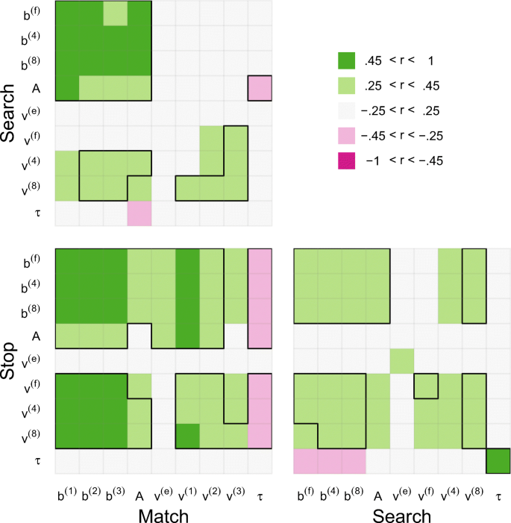
Search vs Stop vs Match Tasks

Slide 29
Projects
Overkill for many things
Scott with covid incubation time
JP Cavallaro consumer choice data (TRDM and other model)
Gavin Cooper consumer choice and SDT
RAAF data
Laura Wall data
Juanita Todd data

Slide 30
Juanita Todd Distraction Task
Distraction paradigm with EEG data
Respond “short” or “long”
Deviant tones throughout
Initial models on easy vs hard task done
Lower drifts for deviants
Higher thresholds post deviant
Now moving to schizophrenia-matched control data
To incorporate Neural data
Could be MVN model of main components
Could use components as a covariate to inform parameters

Slide 31
Projects
Overkill for many things
Scott with covid incubation time
JP Cavallaro consumer choice data (TRDM and other model)
Gavin Cooper consumer choice and SDT
RAAF data
Laura Wall data
Juanita Todd data
Remodelling open data

Slide 32
“Open” Data
Several data sets have arisen in recent weeks which I’ll look to do analysis on over the break
Emotion-decision data
Risk data
Congruity data
Why?
Methods flawed and results could change
Not flawed, but they could miss important bits
Often use simple estimation methods (EZ diffusion etc) or methods that might not be as strong
We could be missing important information

Slide 33
Model Selection
It wouldn’t be a modelling talk without model selection stuff amiright?
We’re working on another set of functions for IS²
Importance sampling squared
This method is very strong and fits in nicely with the sampler
Initial code and results exist

Slide 34
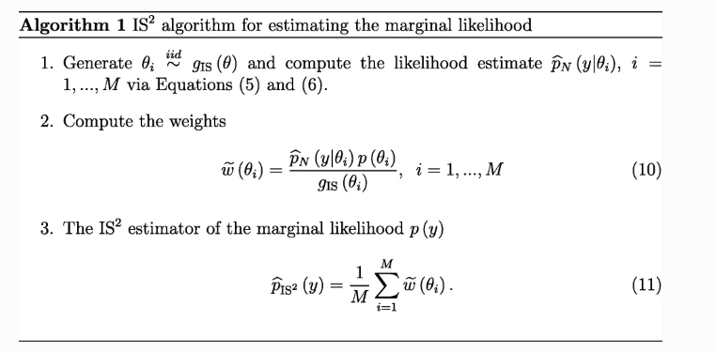
IS²

Slide 35
What’s next?
Get me a flight to Amsterdam
And a house
A bunch of work on those projects and others
Some minor PMwG improvements
More IS² developments
Tutorial article
Variational Bayes and Approximate Bayesian Computation
A follow up workshop on PMwG in R if anyone is interested ☺

Slide 36
Late Jan/Early Feb
~2 hours workshop
Basics of using the sampler
Mainly following our bookdown
First part: Setting up the sampler with your data/likelihood
Second part: Troubleshooting and common problems
PMwG

